Slide 1
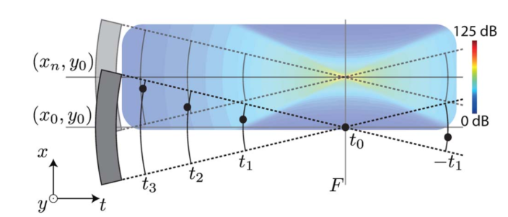
SAFT SNR Degradation
Bar Weiss

Slide 2
Agenda
SAFT results recap
Paper Summary and SNR degradation claims
General overview
SNR analysis and conclusions
SAFT on different shapes

Slide 3
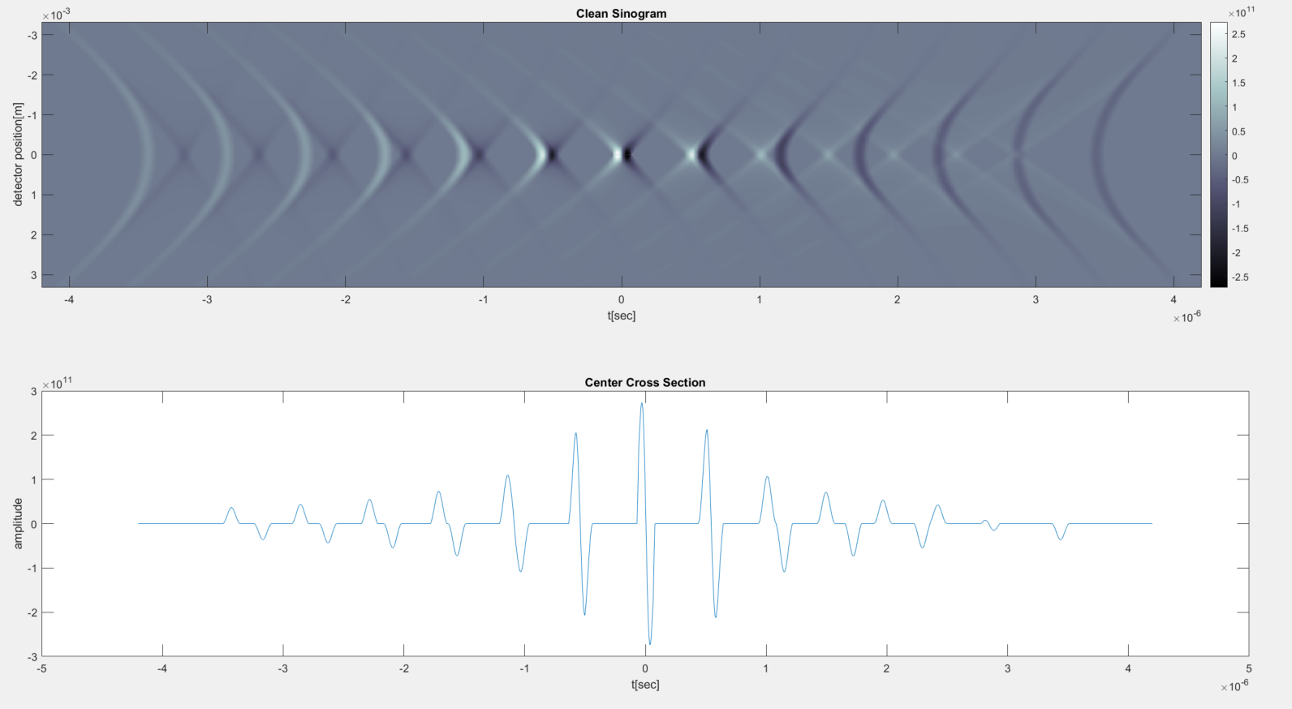
Singoram 50um Gaussian Kernel - Clean

Slide 4
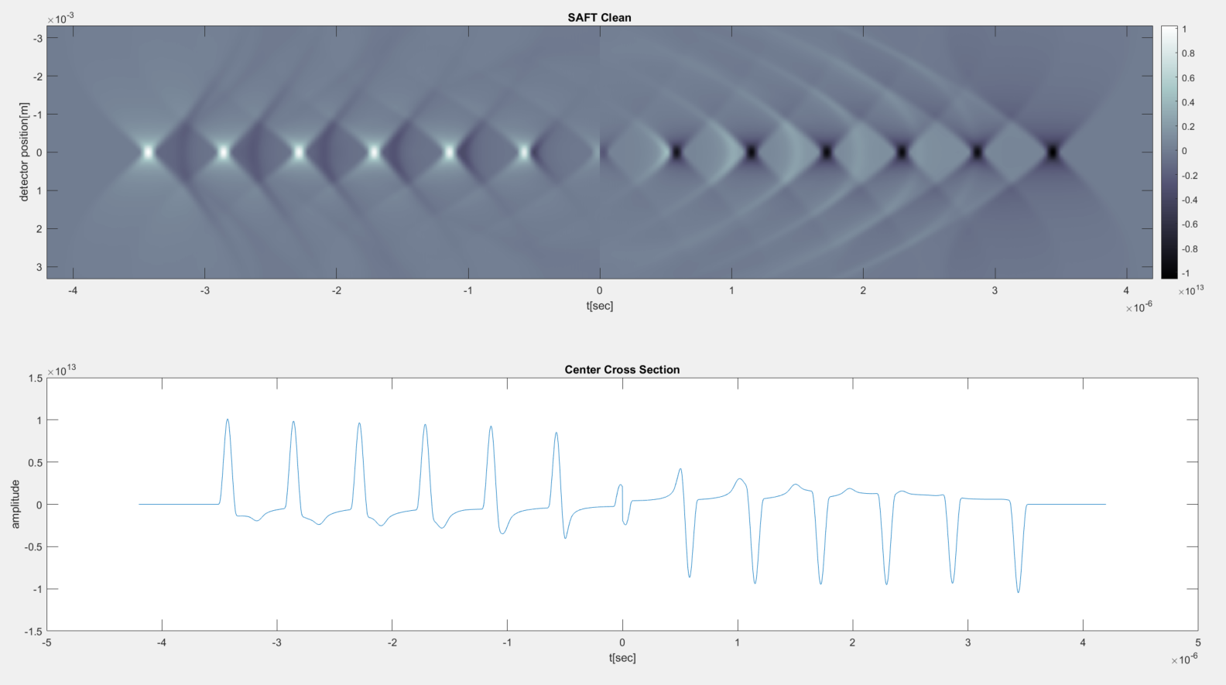
SAFT 50um Gaussian Kernel - Clean

Slide 5
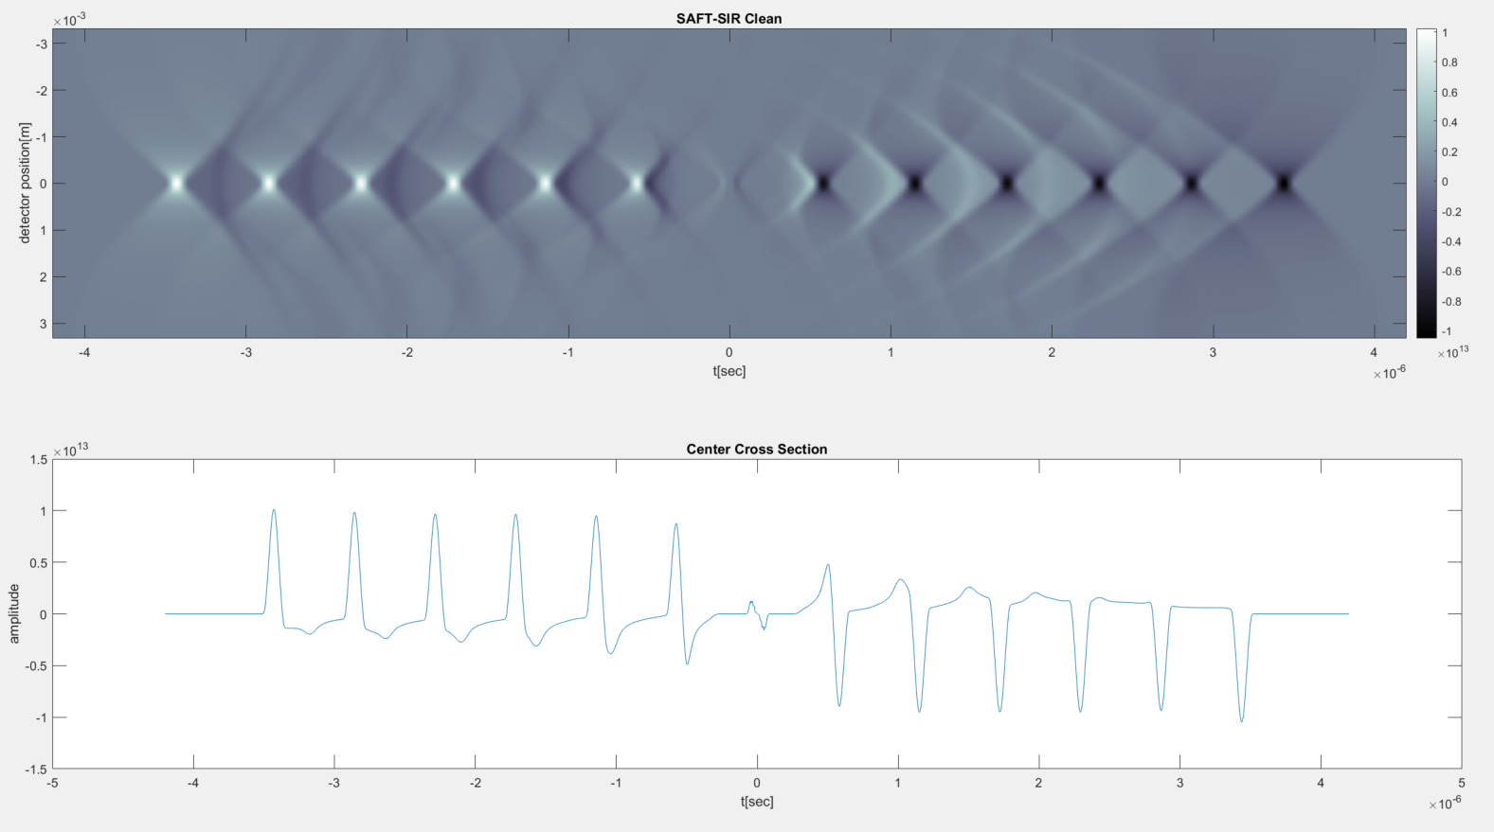
SAFT-SIR 50um Gaussian Kernel - Clean

Slide 6
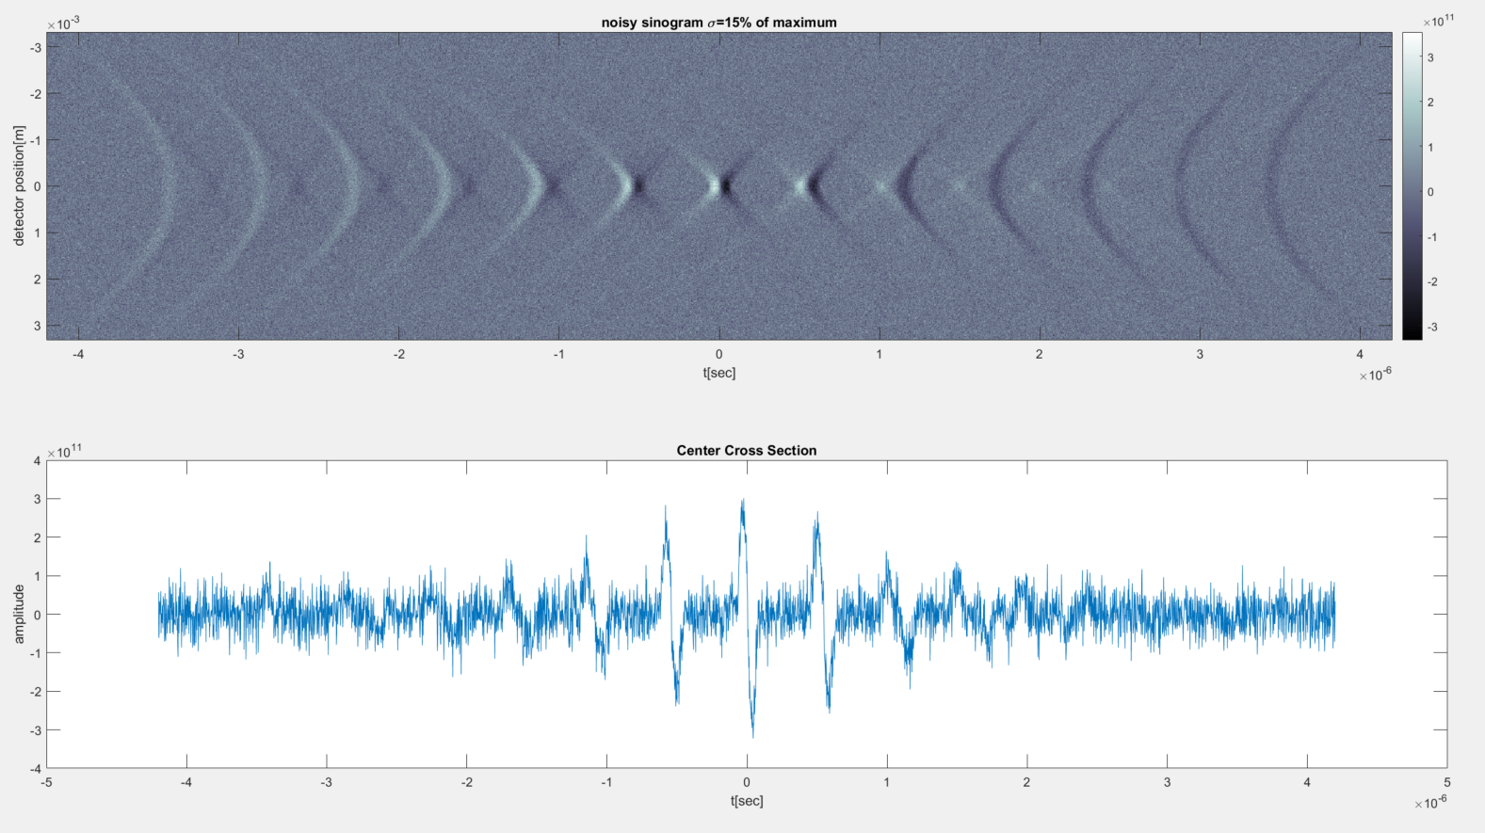
Sinogram 50um Gaussian Kernel - Noisy

Slide 7
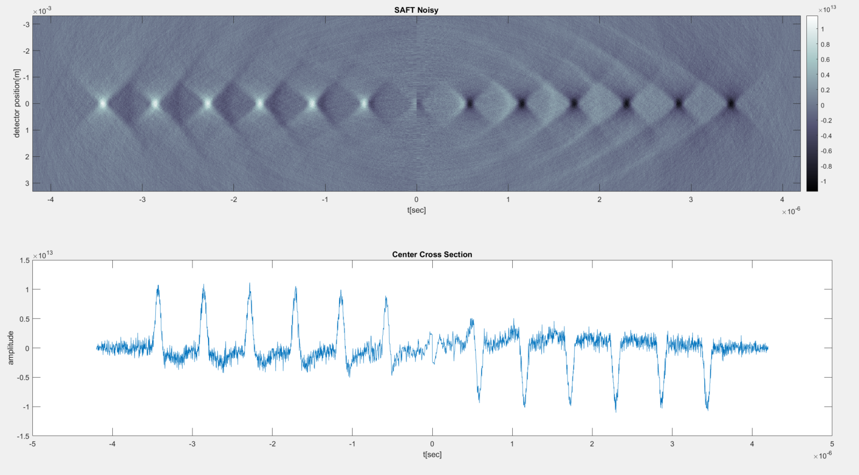
SAFT 50um Gaussian Kernel - Noisy

Slide 8
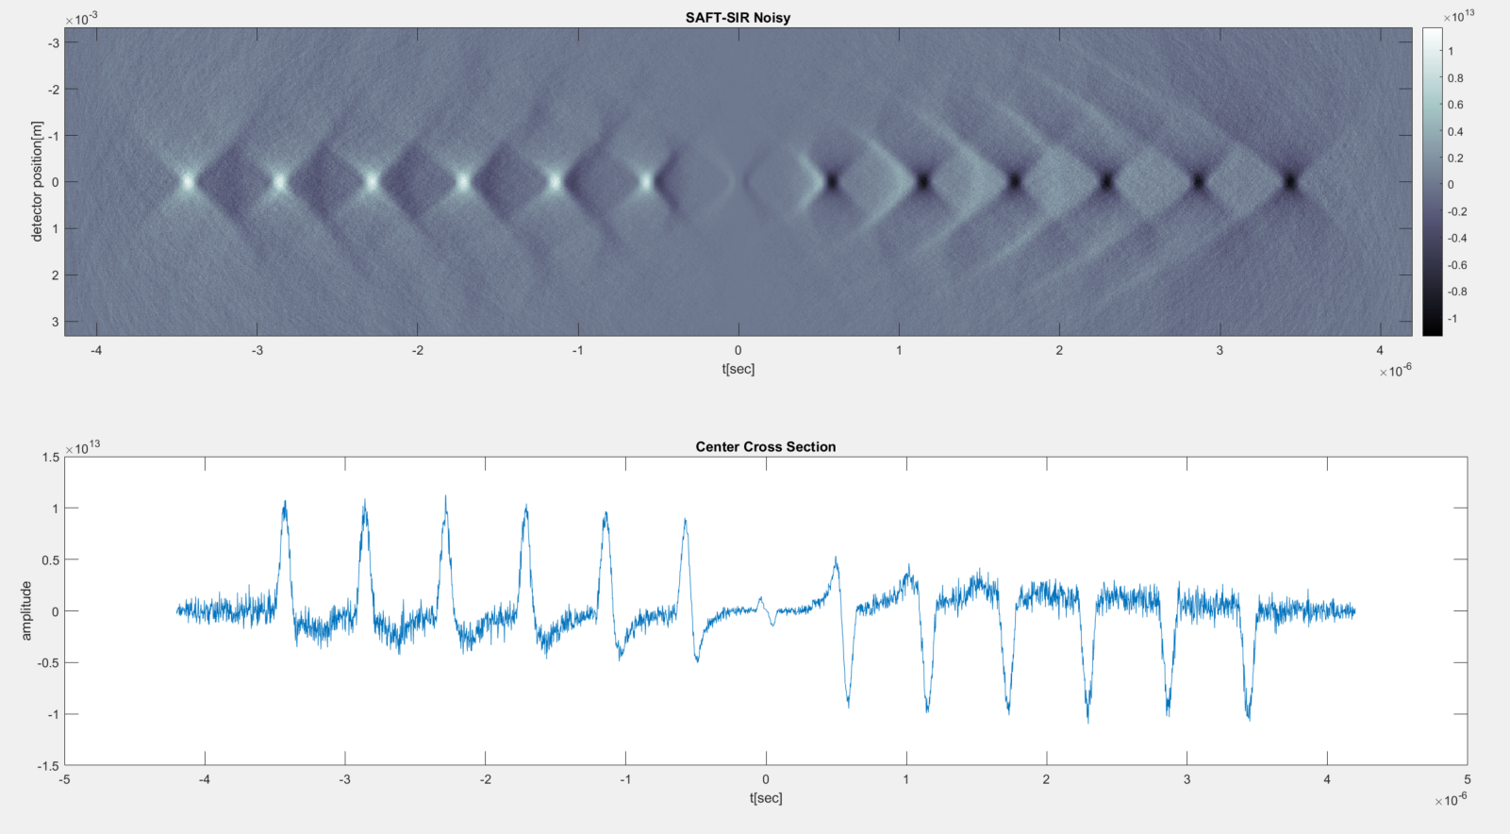
SAFT-SIR 50um Gaussian Kernel - Noisy

Slide 9
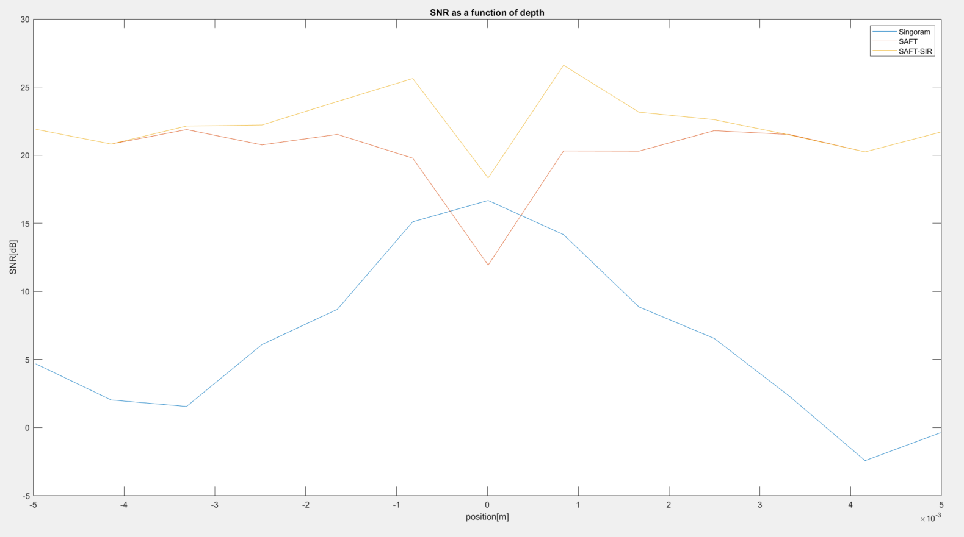
SNR Comparison

Slide 10
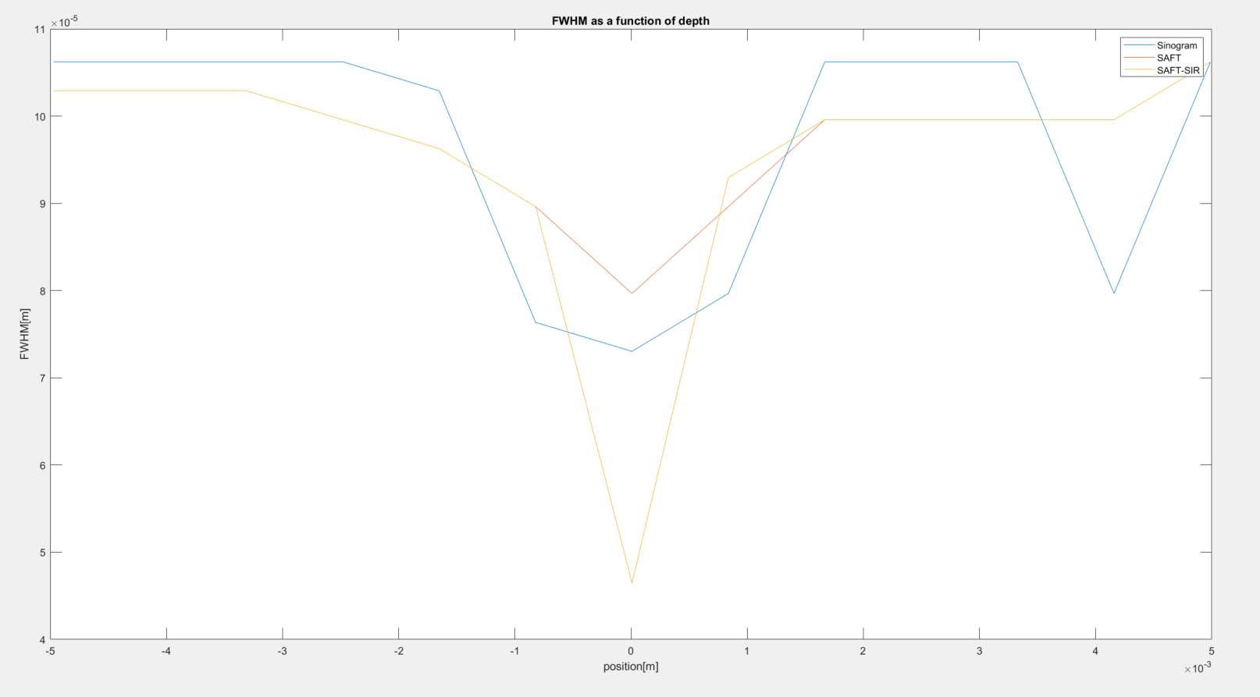
FWHM Comparison

Slide 11
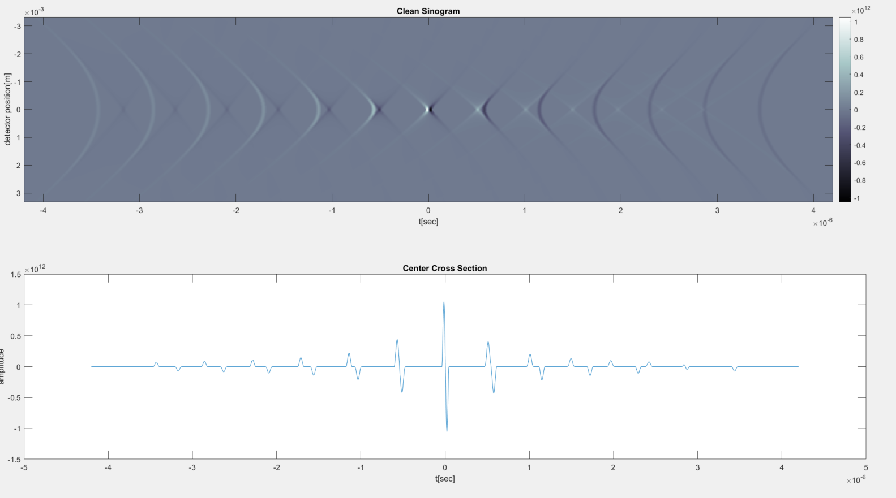
Singoram 25um Gaussian Kernel - Clean

Slide 12
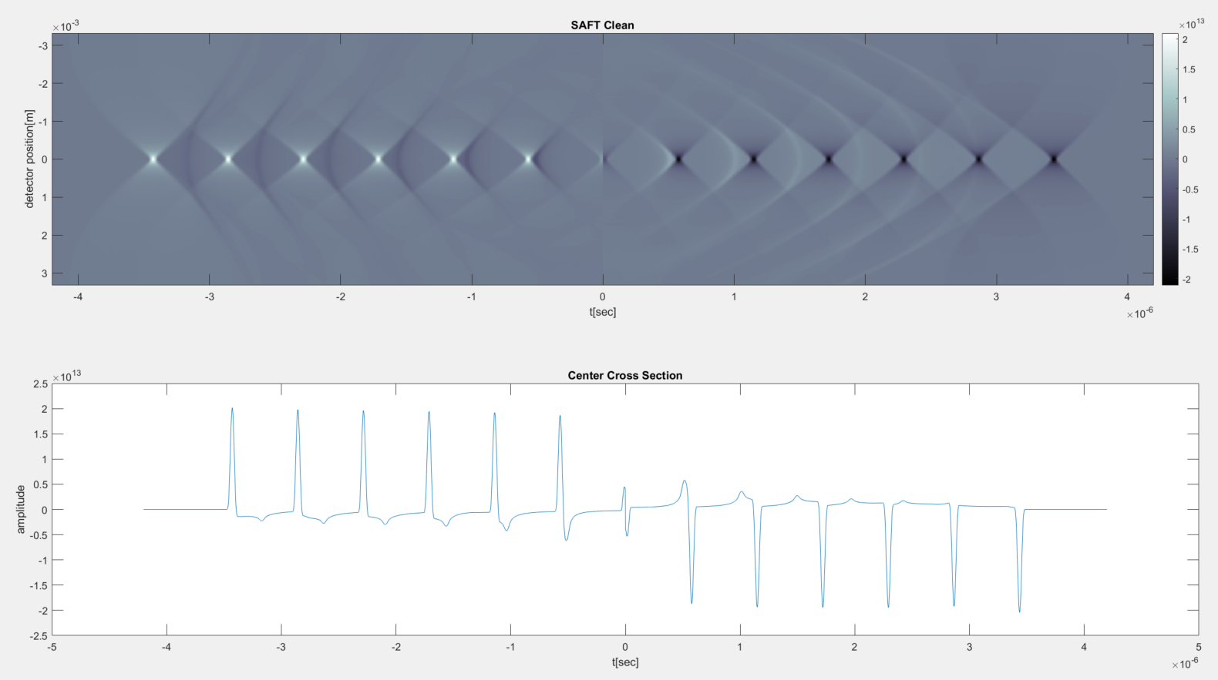
SAFT 25um Gaussian Kernel - Clean

Slide 13
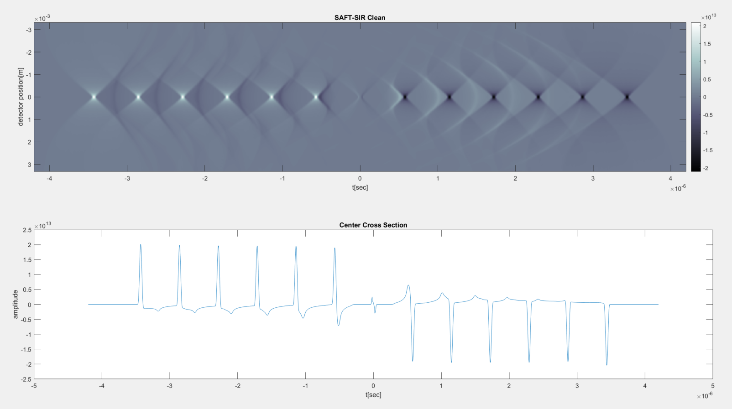
SAFT-SIR 25um Gaussian Kernel - Clean

Slide 14
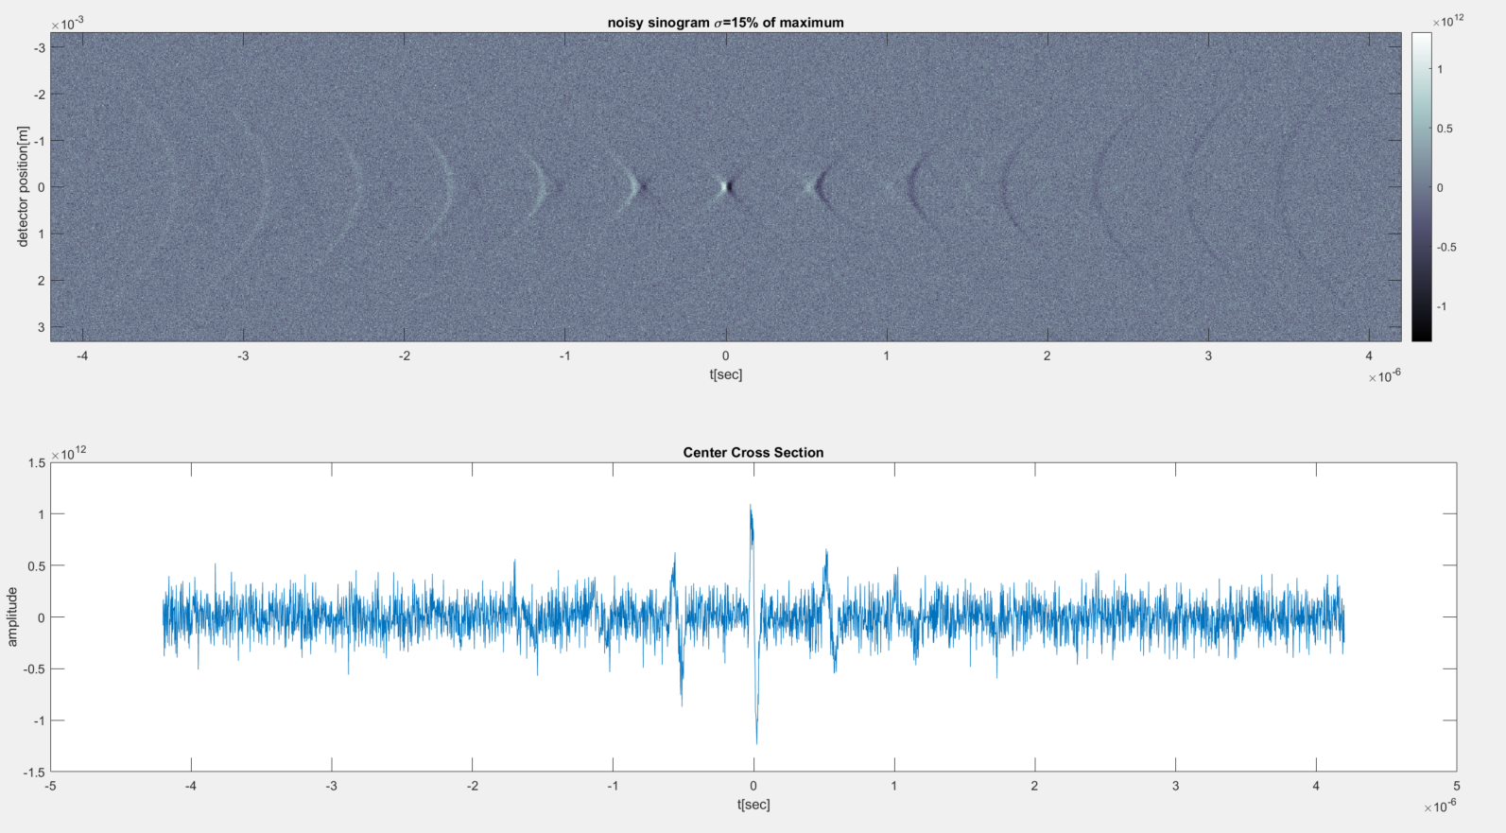
Sinogram 25um Gaussian Kernel - Noisy

Slide 15
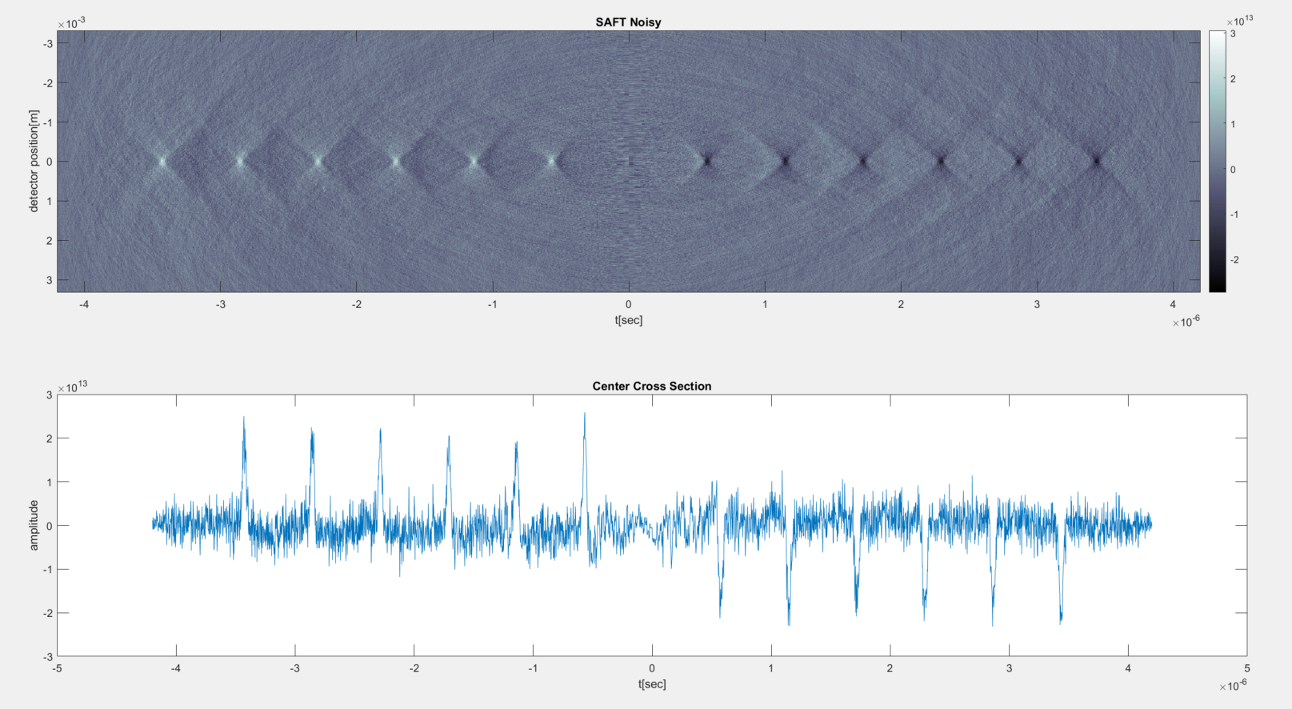
SAFT 25um Gaussian Kernel - Noisy

Slide 16
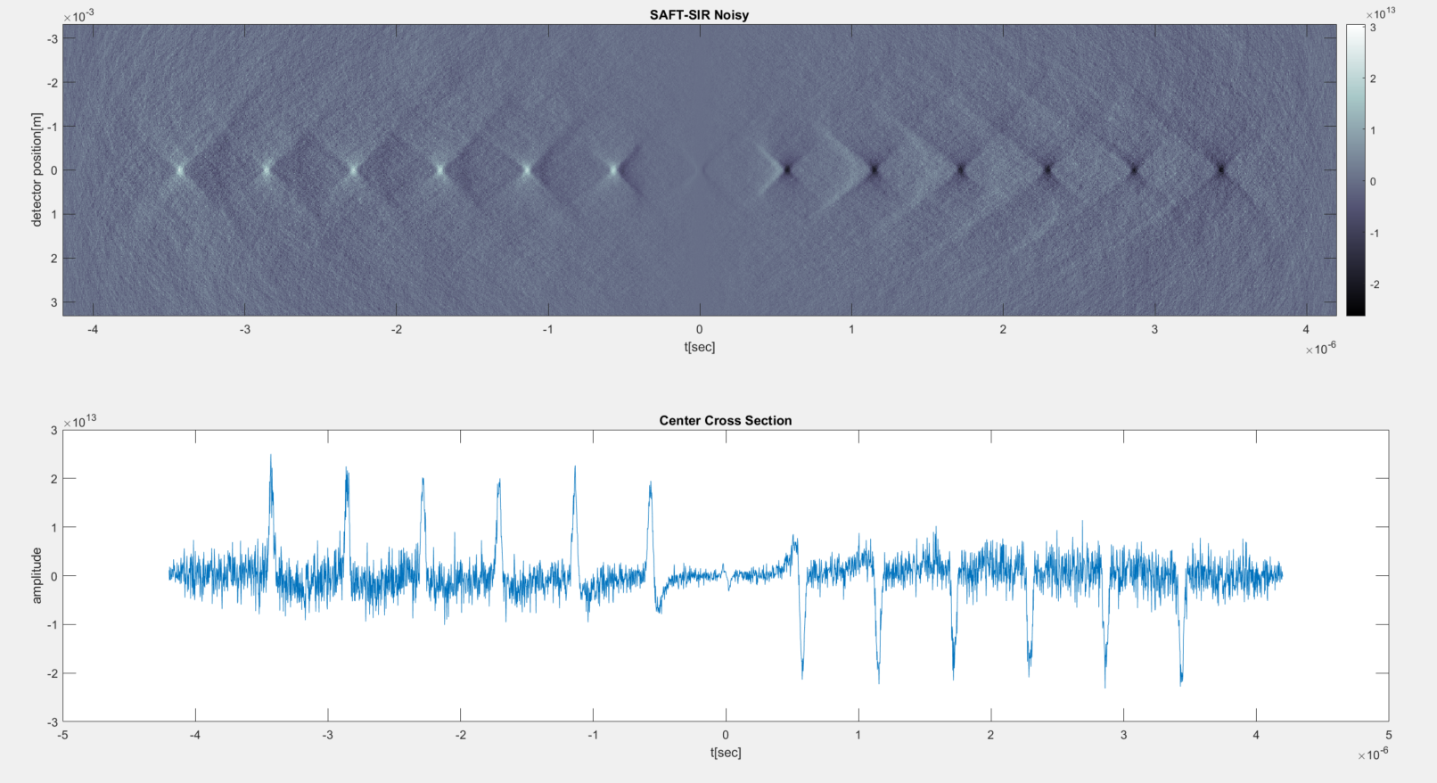
SAFT-SIR 25um Gaussian Kernel - Noisy

Slide 17
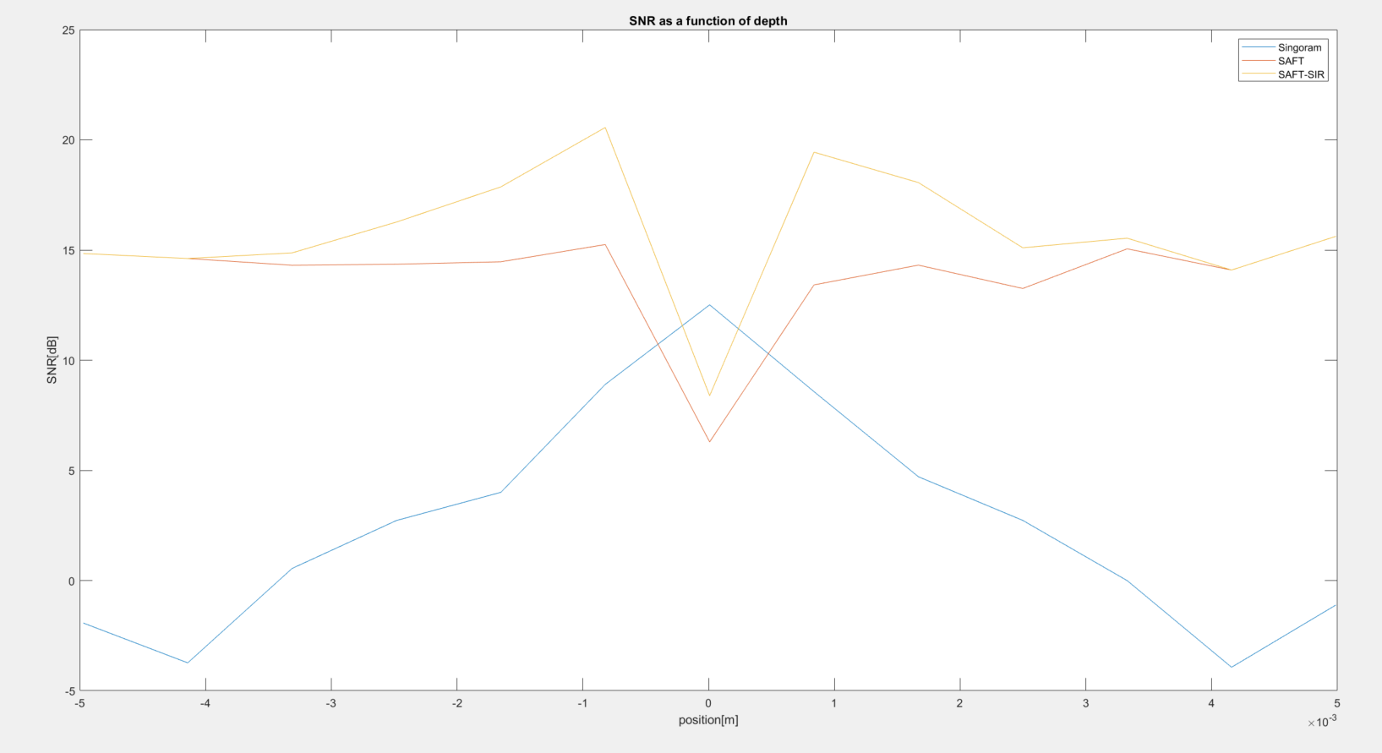
SNR Comparison

Slide 18
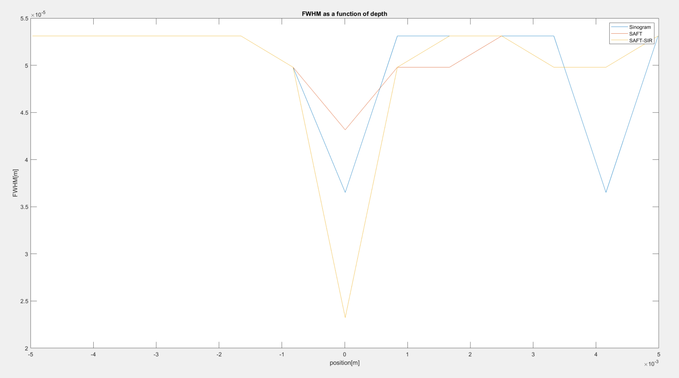
FWHM Comparison

Slide 19
Paper Summary
A Novel 2-D Synthetic Aperture Focusing Technique for Acoustic-Resolution Photoacoustic Microscopy

Slide 20
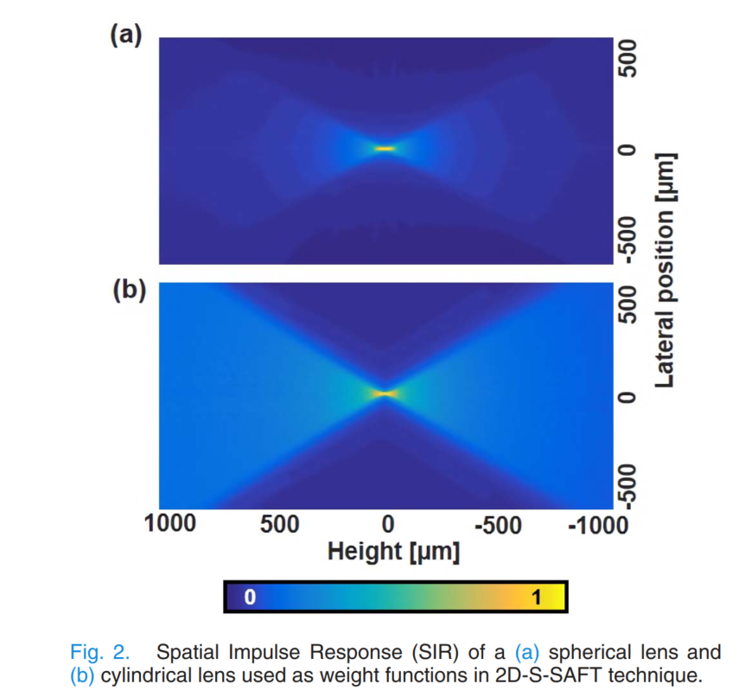
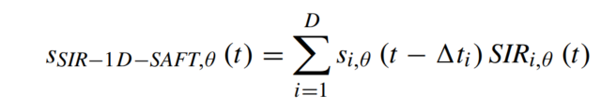
SIR in SAFT
The SIR here is a weighting function to rectify the different spatial contributions to the SAFT sum.
This is different from the SIR that we use to create the sinograms.
They generated it using DREAM toolbox in MATLAB

Slide 21
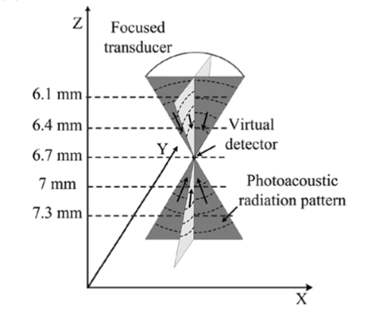
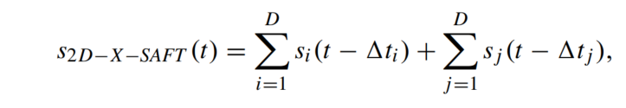
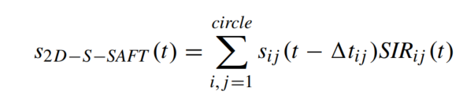
SAFT Techniques Referenced

Slide 22
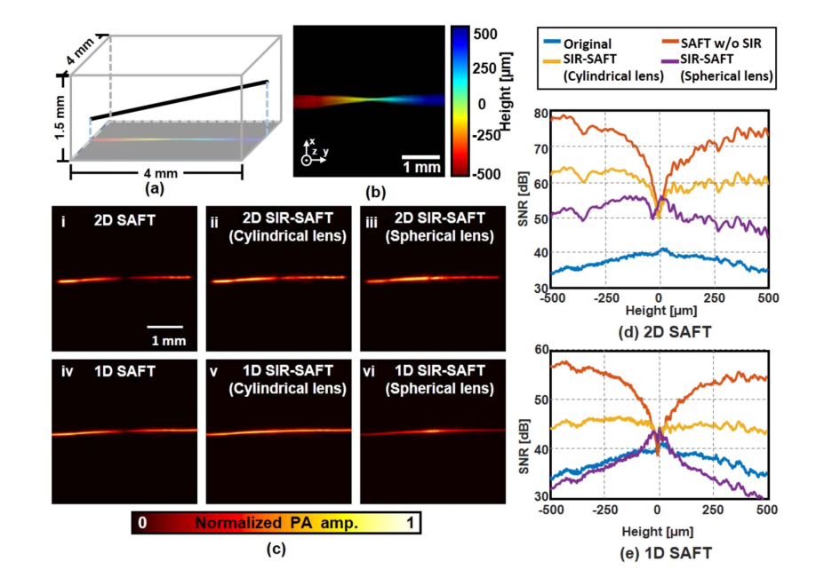
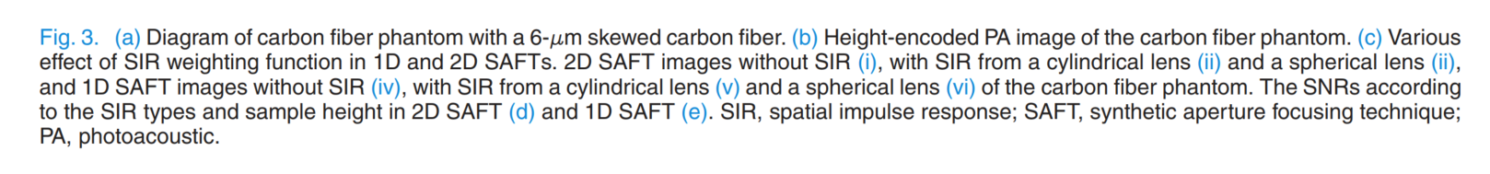
Methods Comparison – SNR & FWHM

Slide 23
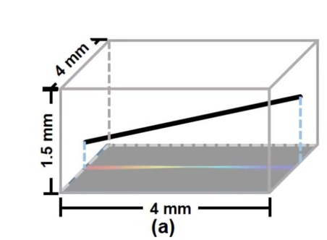
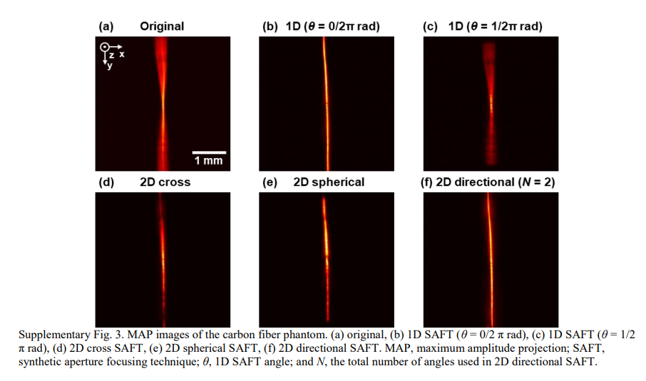
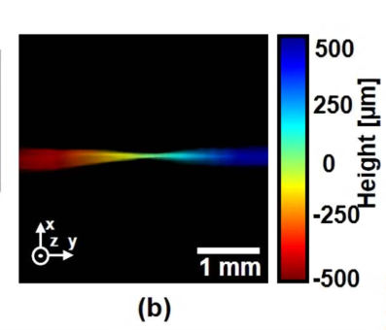
Methods Comparison – Experiment

Slide 24
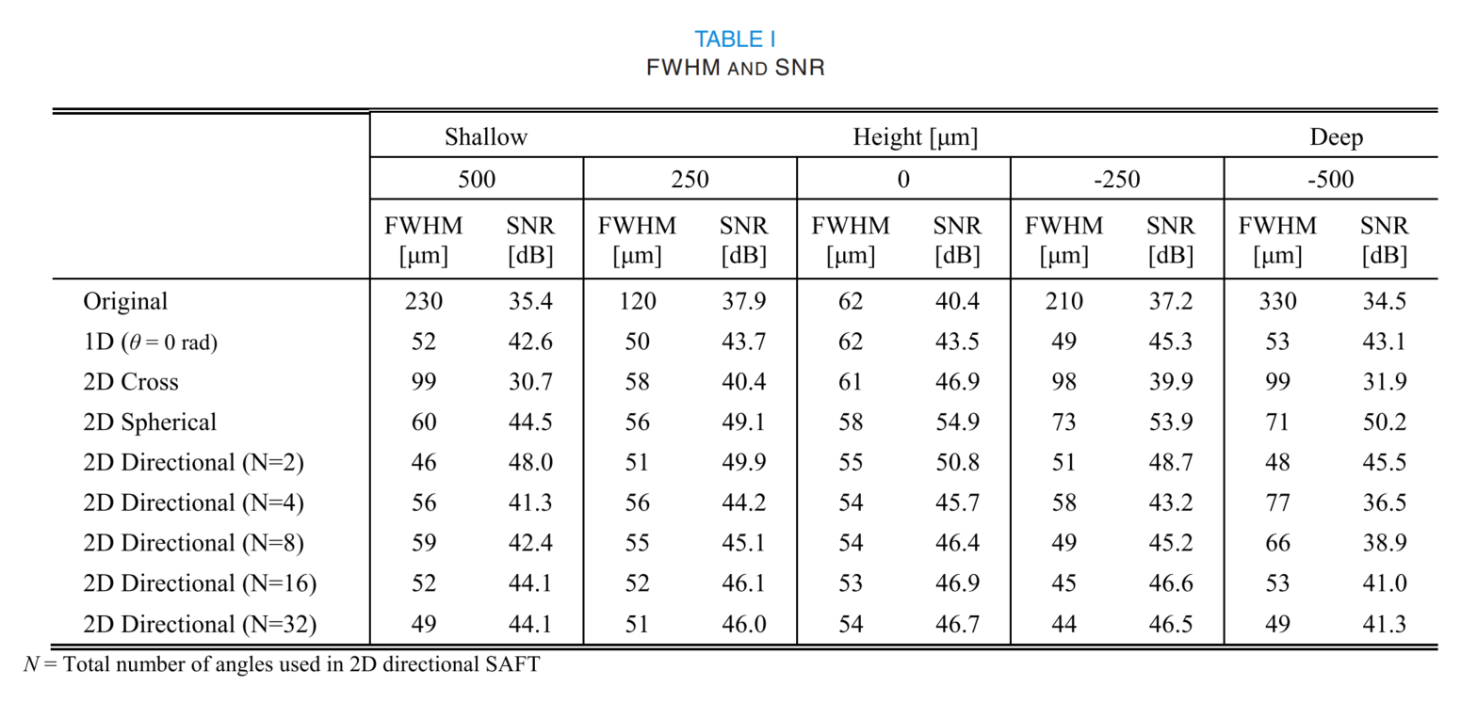
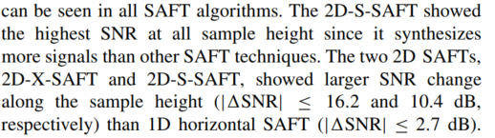
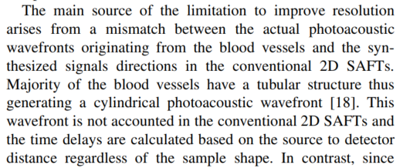
Methods Comparison – SNR & FWHM

Slide 25
Suggested New Method - Directional SAFT
The idea is that blood vessels create wavefronts with delays that match the 1D-SAFT case along the direction of the vessel.
We want to combine several 1D-SAFTs along different directions and then we can get good lateral resolution for images with tubular structure like blood vessels.

Slide 26
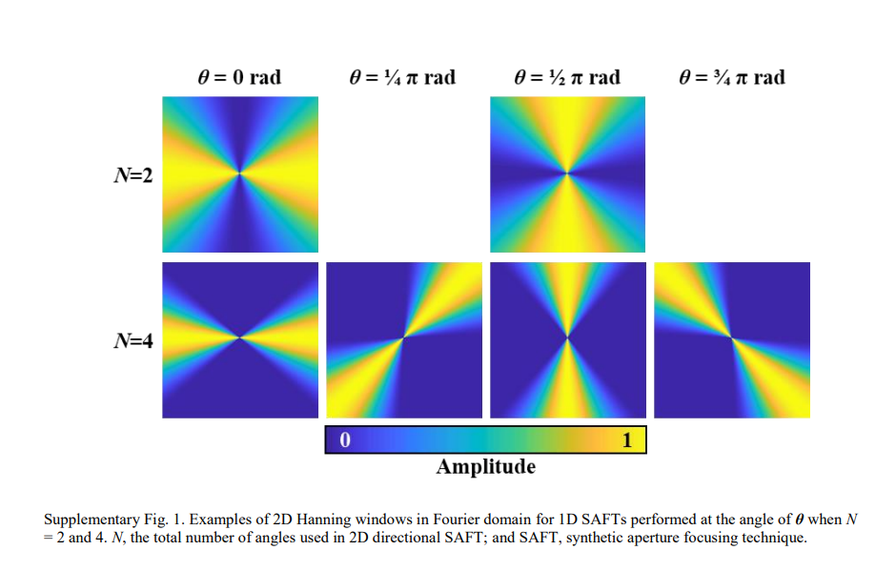
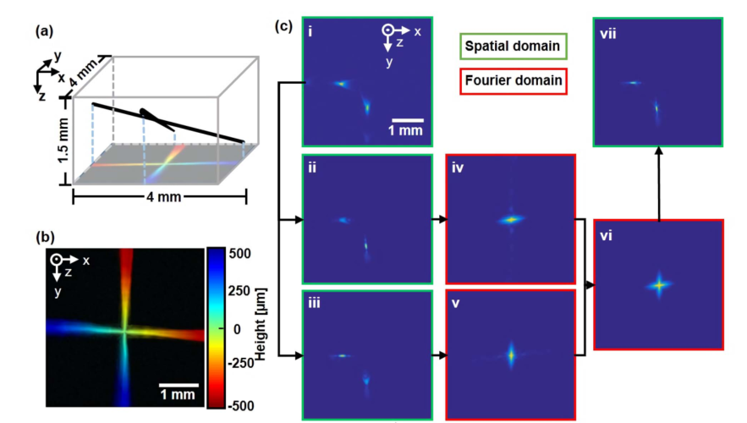
Directional SAFT

Slide 27
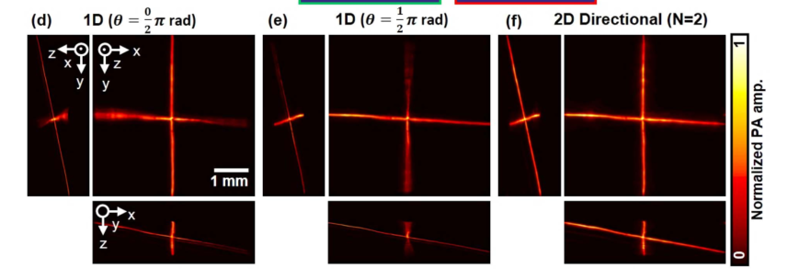
Directional SAFT - Results

Slide 28
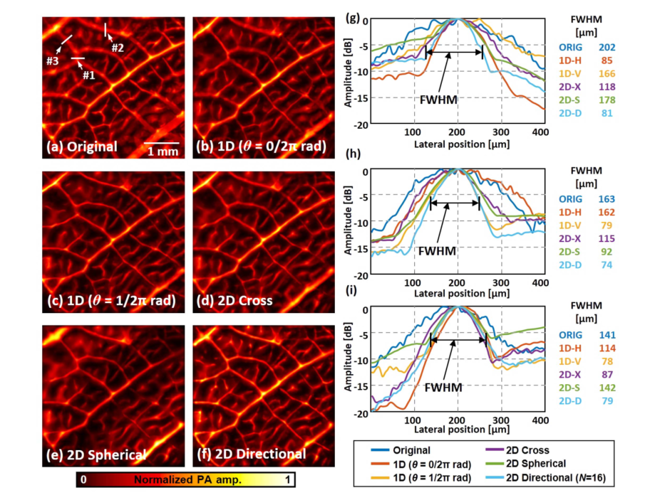
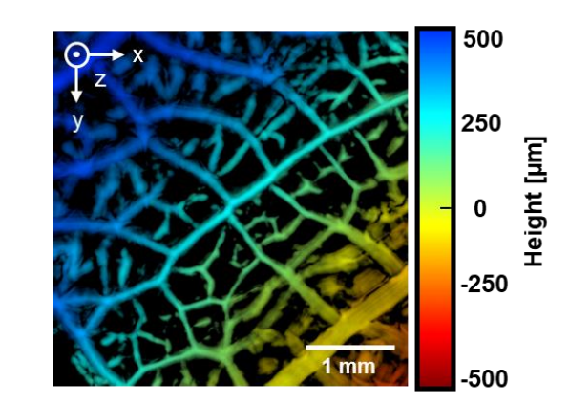
Leaf Skeleton Results

Slide 29
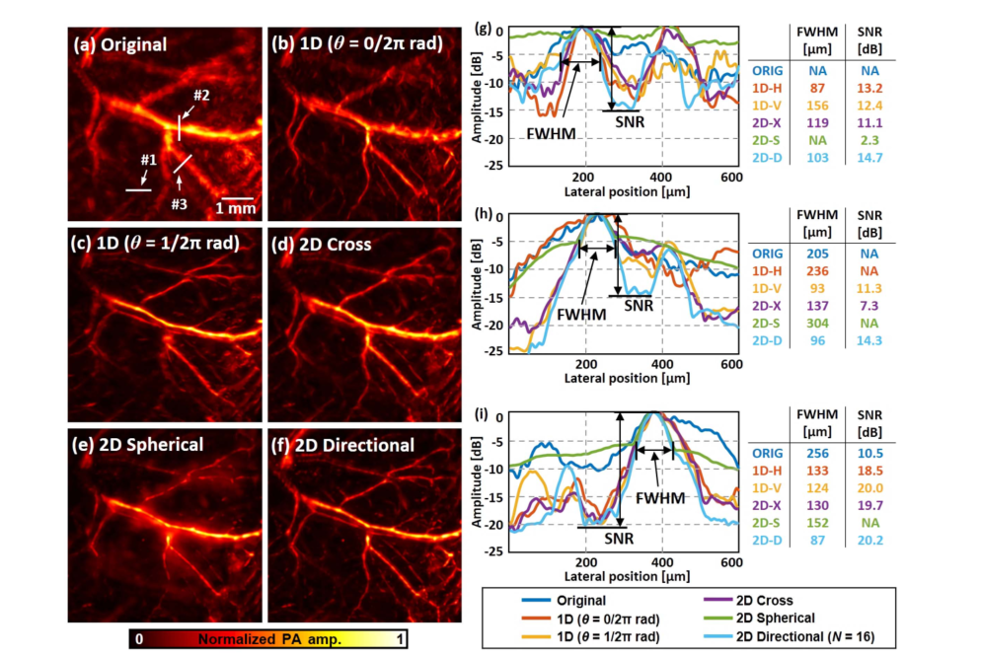
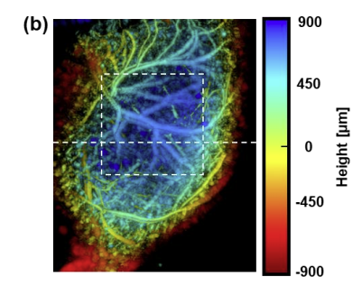
Mouse Hind Limb Results

Slide 30
SAFT on Different Objects
Vertical lines
Horizontal lines
Circles

Slide 31
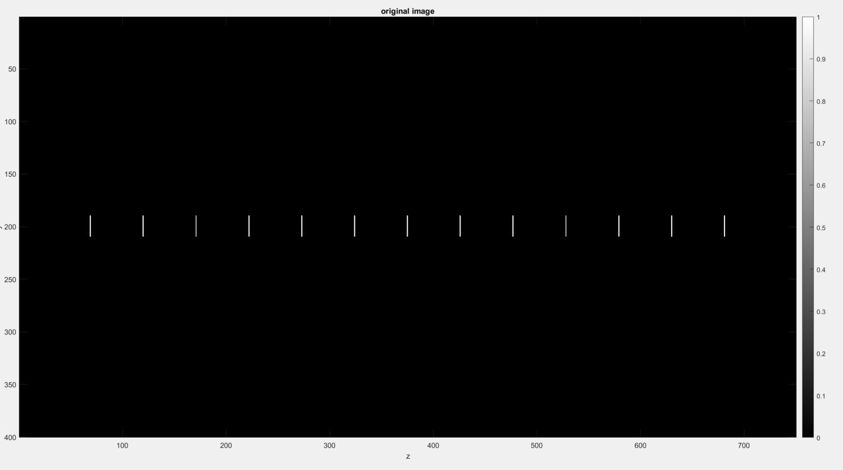
Vertical Lines

Slide 32
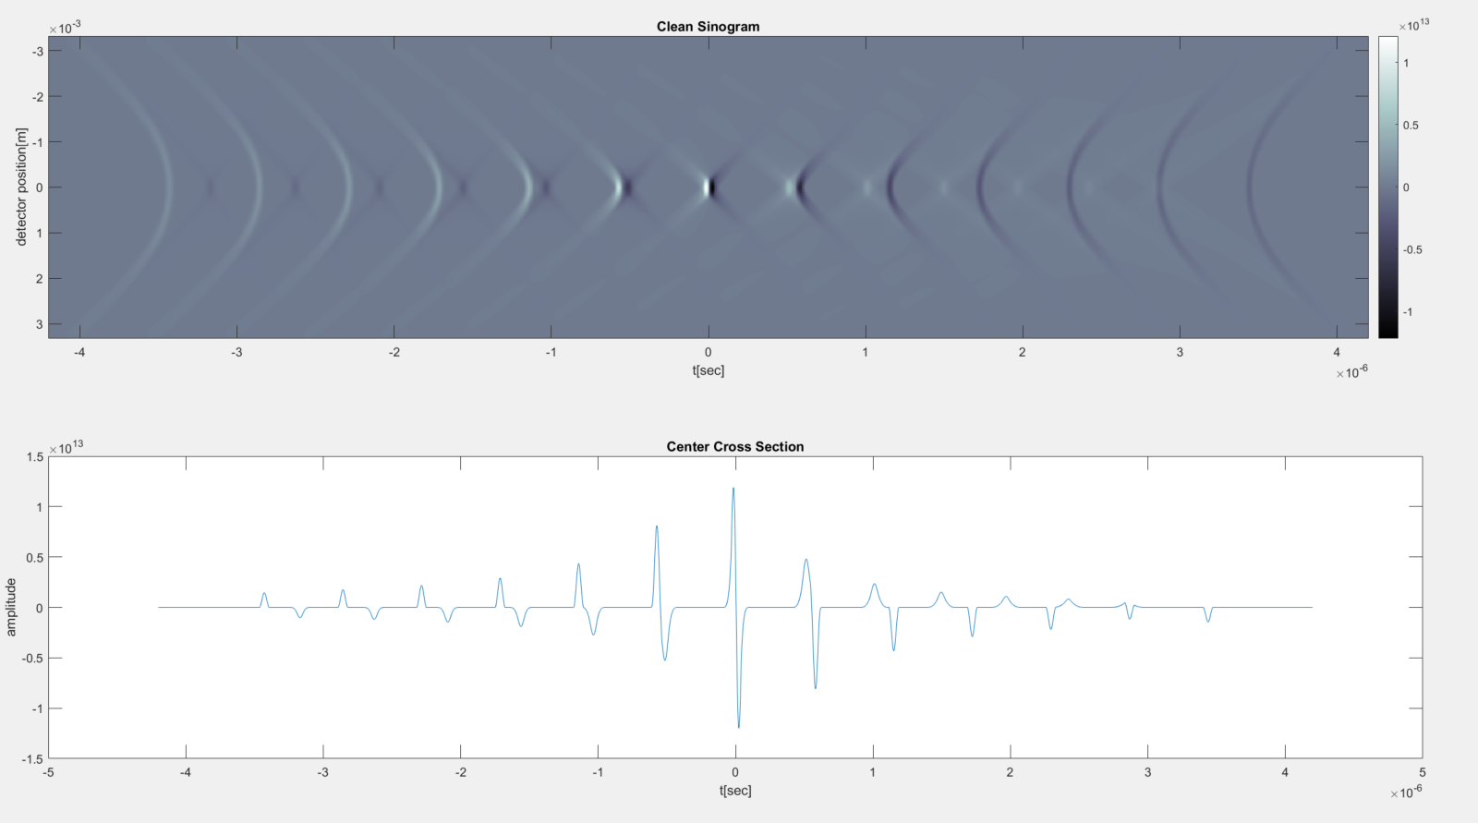
Vertical Lines – Clean Sinogram

Slide 33
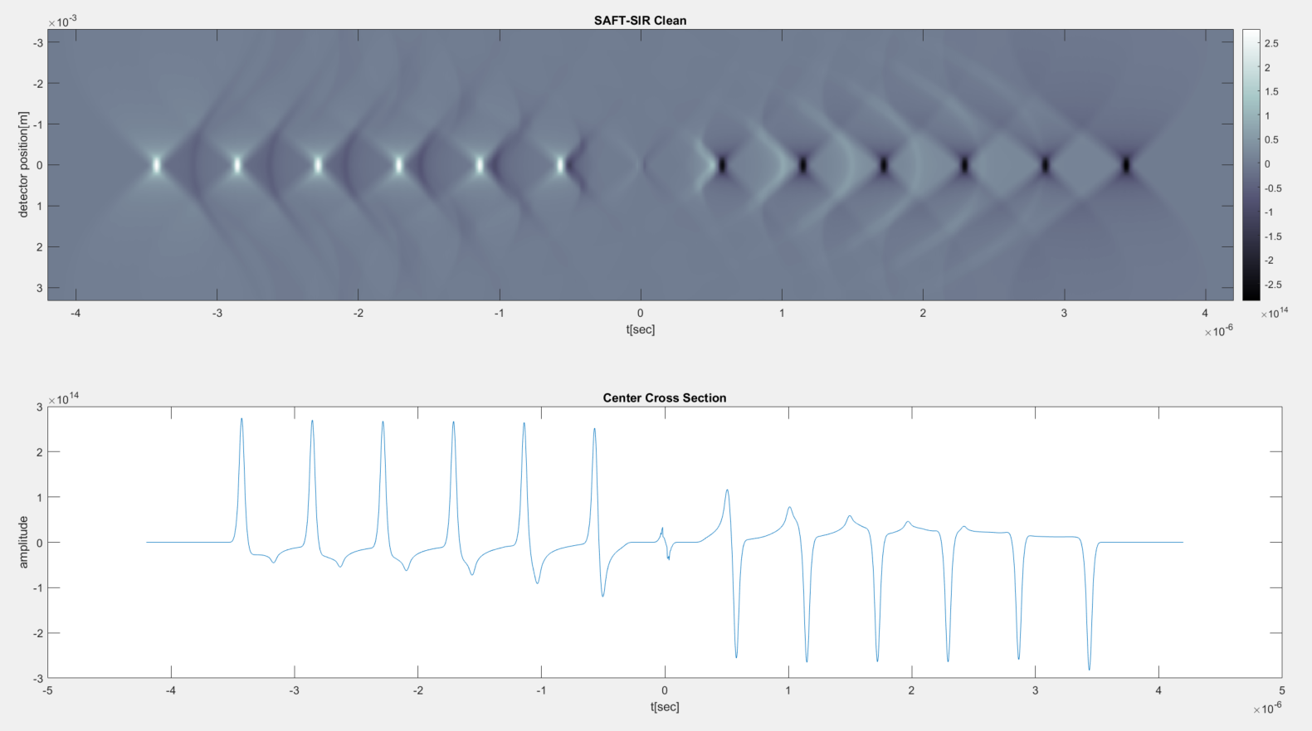
Vertical Lines – Clean SAFT-SIR

Slide 34
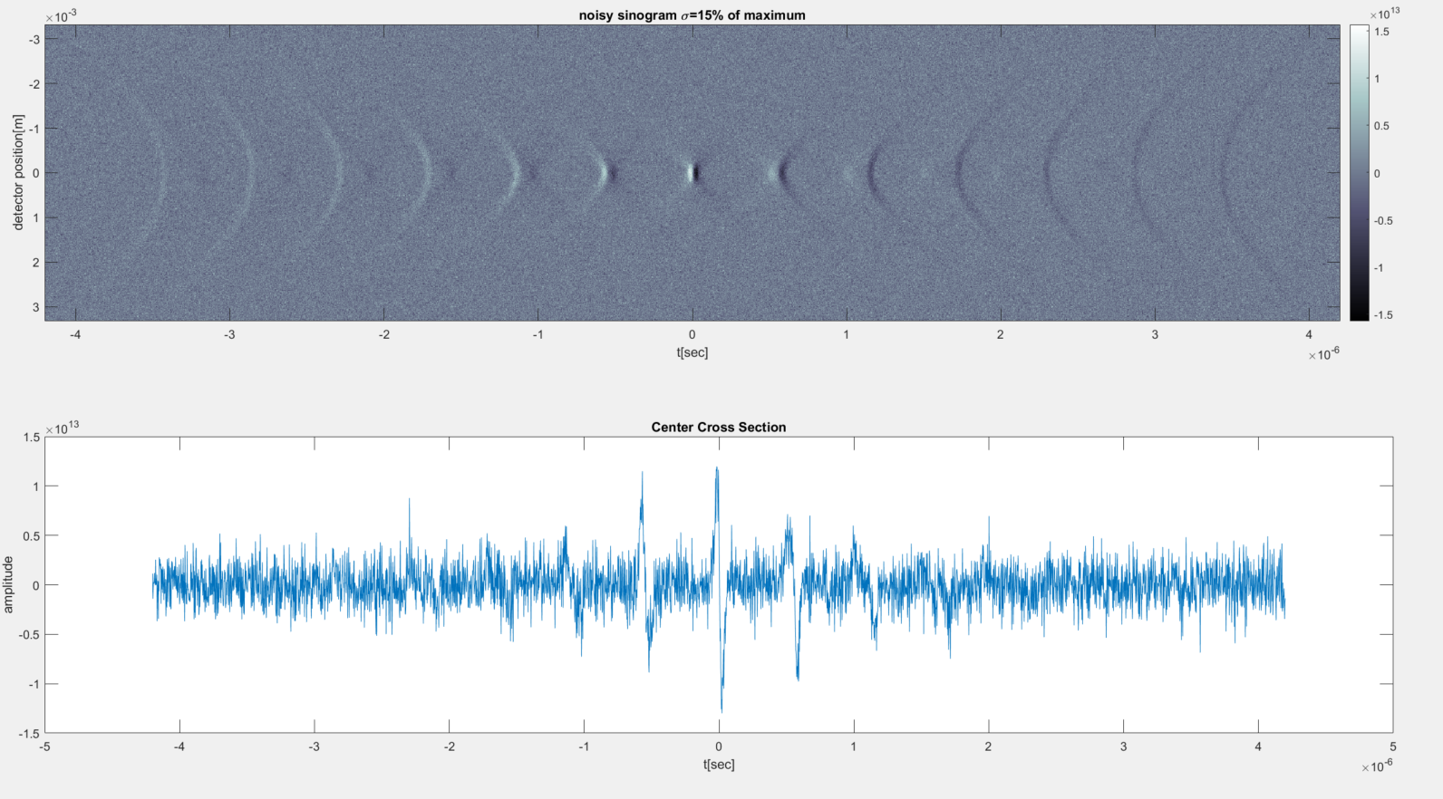
Vertical Lines – Noisy Sinogram

Slide 35
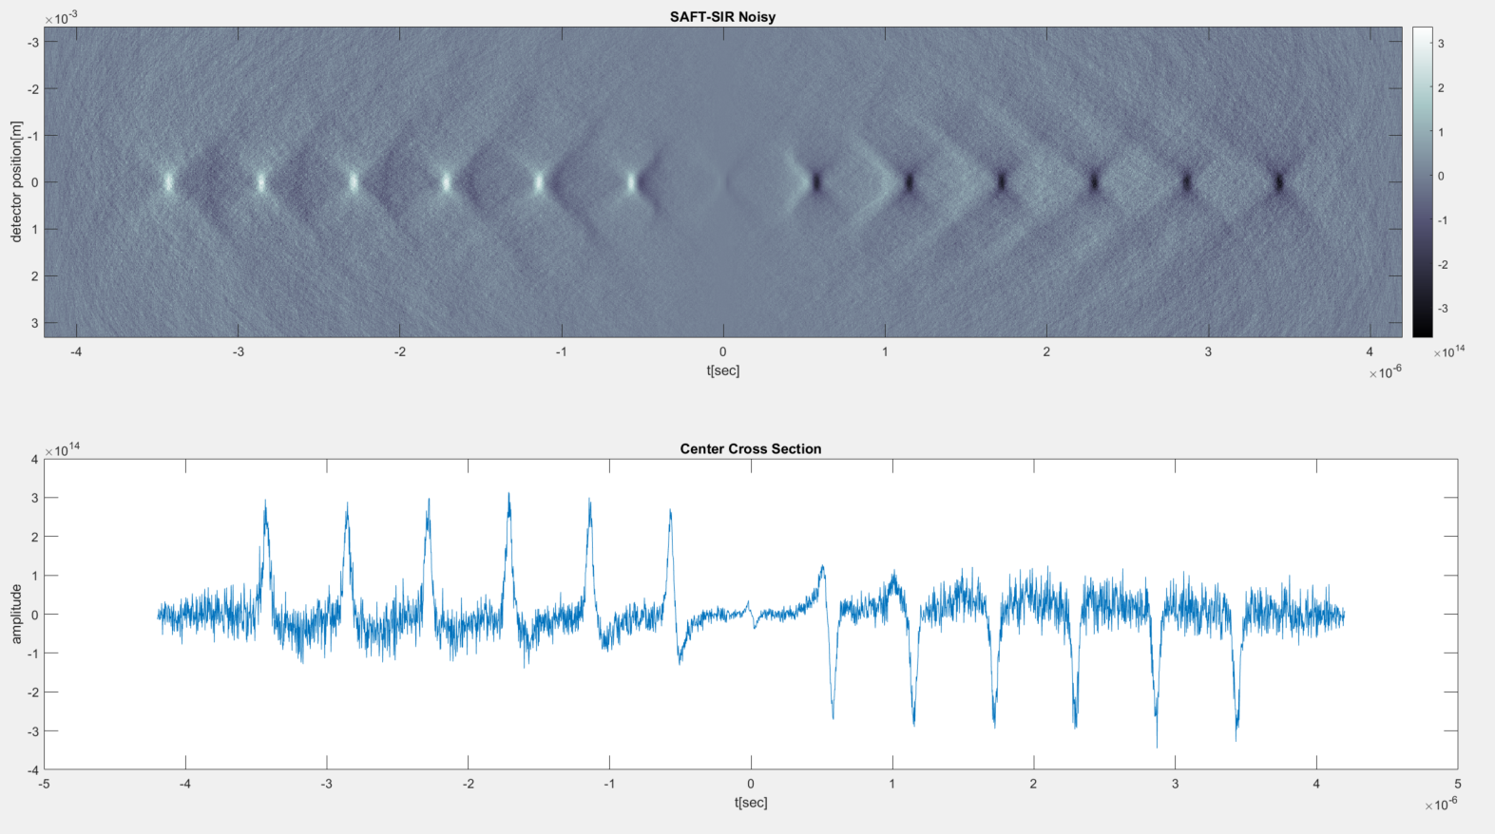
Vertical Lines – Noisy SAFT-SIR

Slide 36
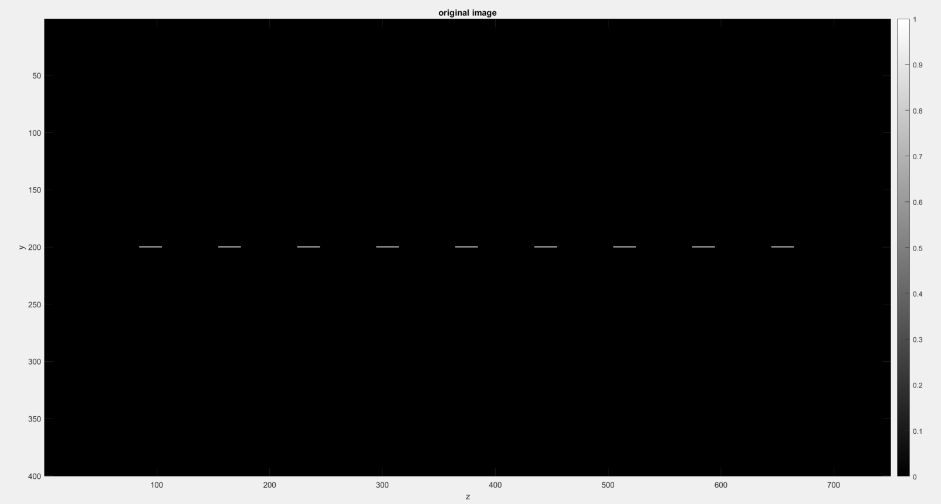
Horizontal Lines

Slide 37
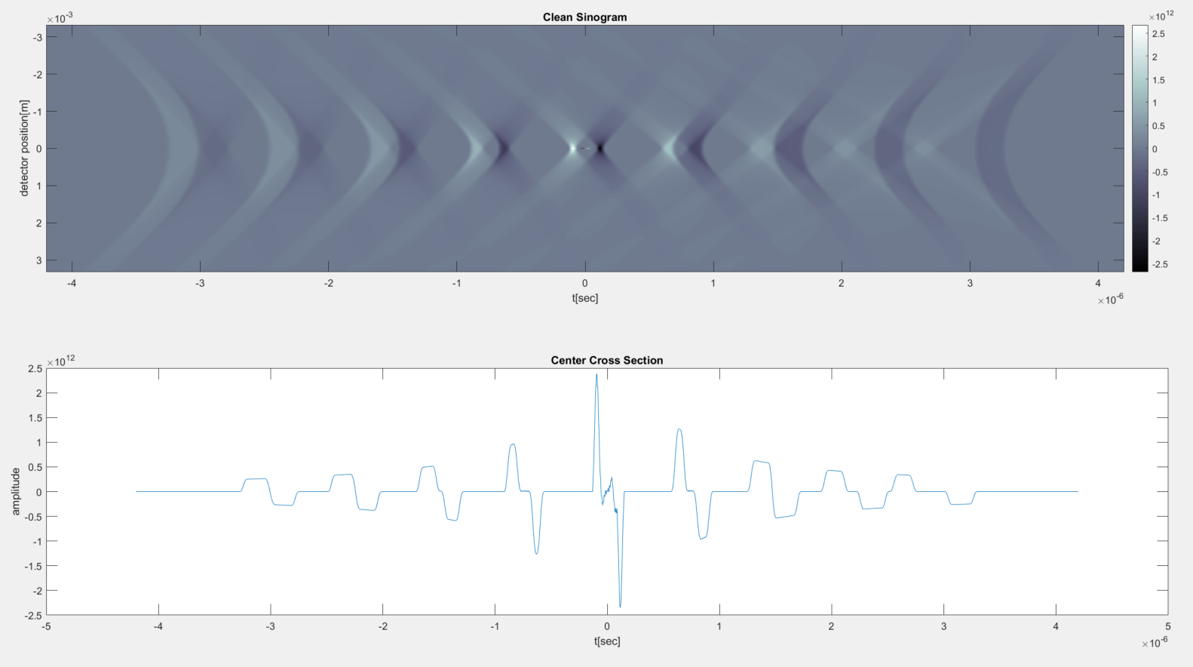
Horizontal Lines – Clean Sinogram

Slide 38
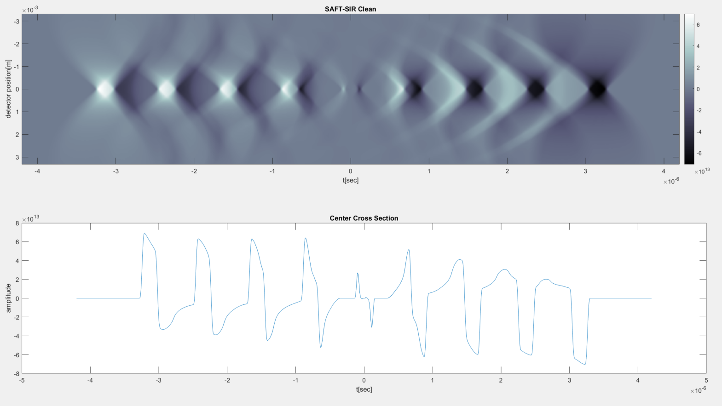
Horizontal Lines – Clean SAFT-SIR

Slide 39
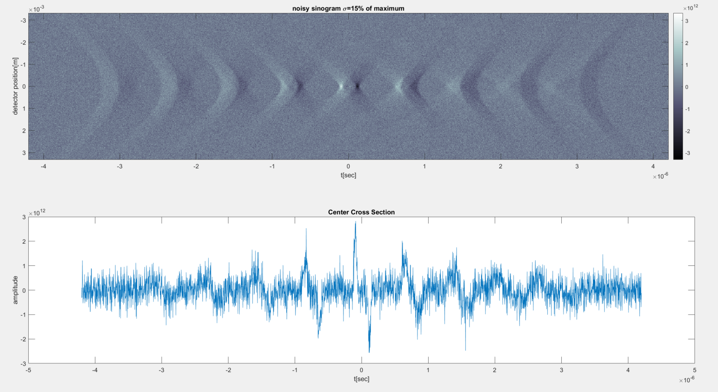
Horizontal Lines – Noisy Sinogram

Slide 40
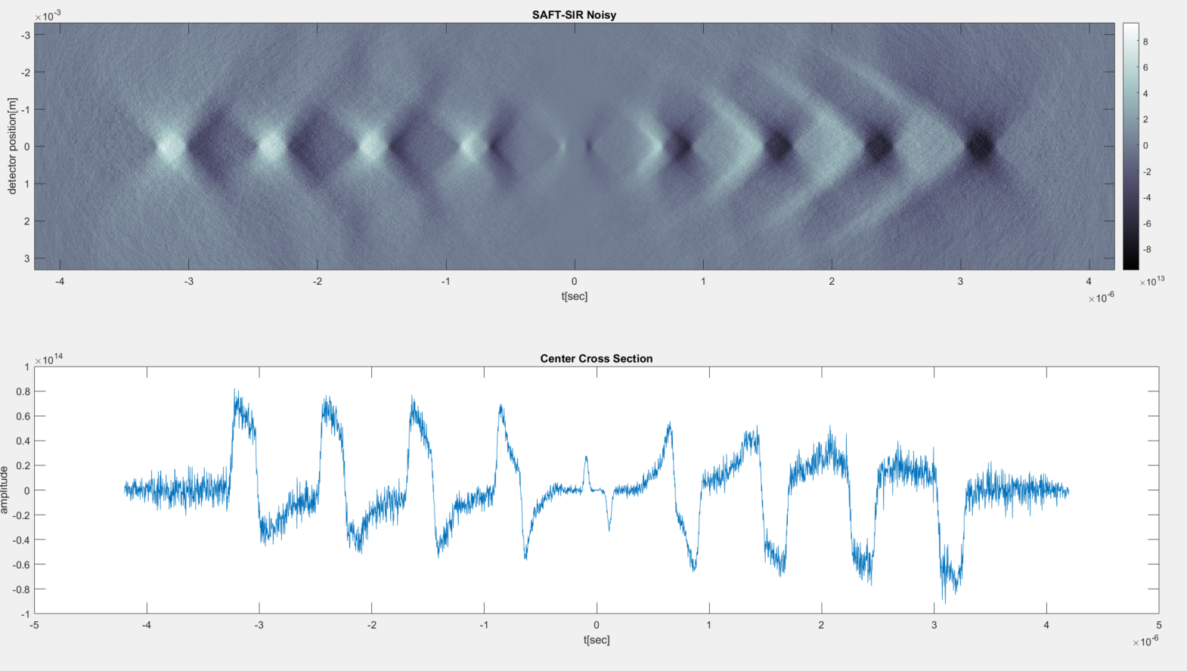
Horizontal Lines – Noisy SAFT-SIR

Slide 41
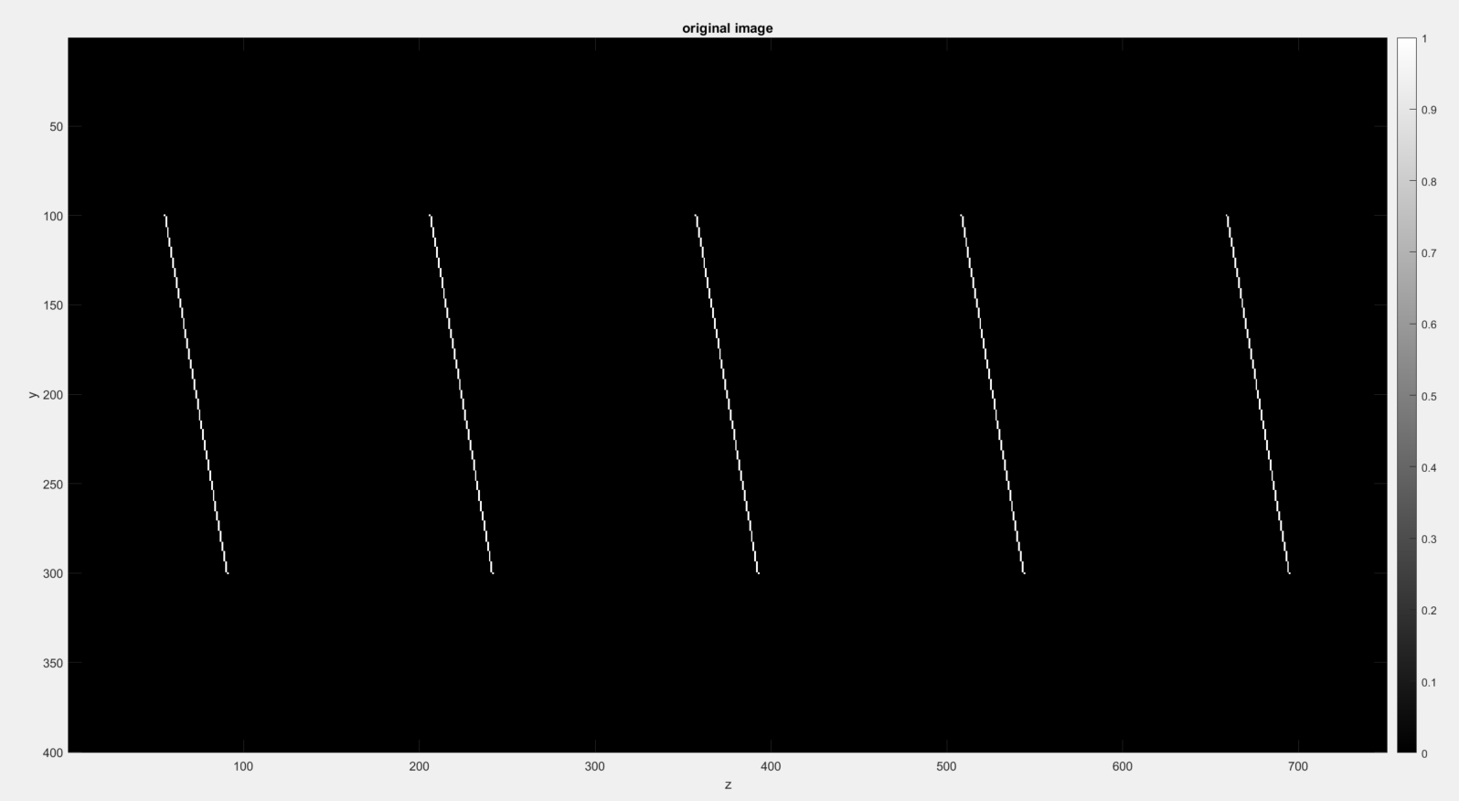
10 degrees Angled Line

Slide 42
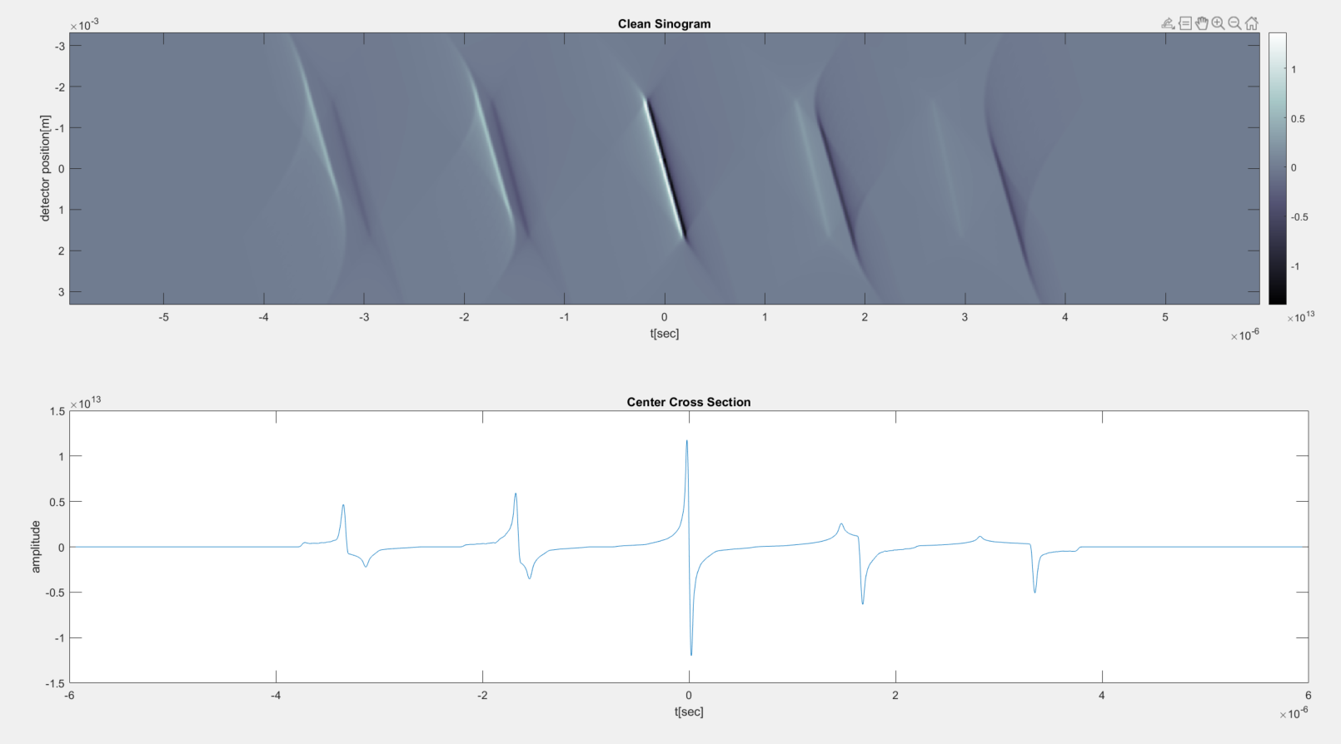
10 degrees Angled Line – Clean Sinogram

Slide 43
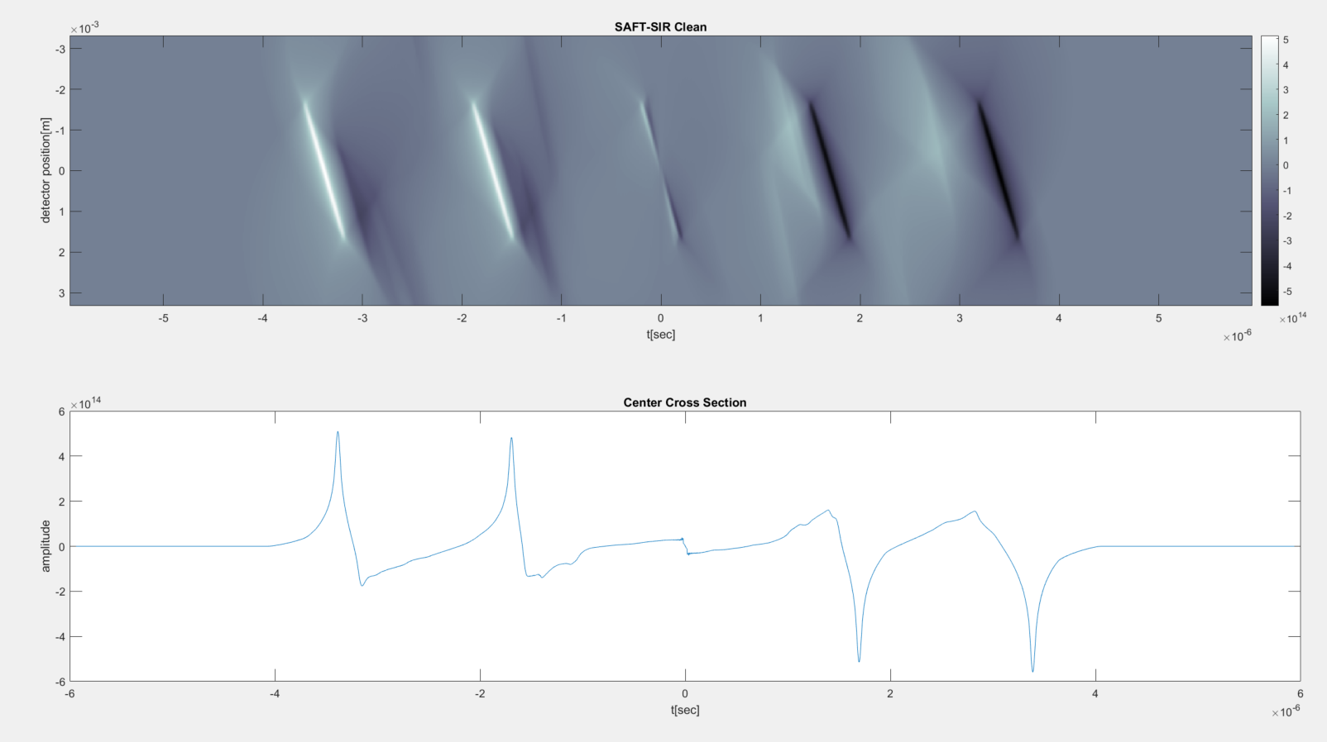
10 degrees Angled Line – Clean SAFT-SIR

Slide 44

10 degrees Angled Line – Noisy Sinogram

Slide 45

10 degrees Angled Line – Noisy SAFT-SIR

Slide 46

20 degrees Angled Line

Slide 47

20 degrees Angled Line – Clean Sinogram

Slide 48

20 degrees Angled Line – Clean SAFT-SIR

Slide 49

20 degrees Angled Line – Noisy Sinogram

Slide 50

20 degrees Angled Line – Noisy SAFT-SIR

Slide 51

30 degrees Angled Line

Slide 52

30 degrees Angled Line – Clean Sinogram

Slide 53

30 degrees Angled Line – Clean SAFT-SIR

Slide 54

30 degrees Angled Line – Noisy Sinogram

Slide 55

30 degrees Angled Line – Noisy SAFT-SIR

Slide 56

Circles

Slide 57

Circles – Clean Sinogram

Slide 58

Circles – Clean SAFT-SIR

Slide 59

Circles – Noisy Sinogram

Slide 60

Circles – Noisy SAFT-SIR

Slide 61

Circles with Intensity decline

Slide 62

Circles – Clean Sinogram

Slide 63

Circles – Clean SAFT-SIR

Slide 64

Circles – Noisy Sinogram

Slide 65

Circles – Noisy SAFT-SIR

Slide 66
Backup

Slide 67


SAFT $N$ Window weight
$$\sum_{i=1}^{N}{w_{i}}=N$$

Slide 68



SAFT $\sqrt{N}$ Window weight
$$\sum_{i=1}^{N}{w_{i}}=\sqrt{N}$$

Slide 69
References
Rongkang Gao, Qiang Xue, Yaguang Ren, Hai Zhang, Liang Song, Chengbo Liu, “Achieving depth-independent lateral resolution in AR-PAM using the synthetic-aperture focusing technique”, Photoacoustics, Volume 26, 2022
Jake Turner, Héctor Estrada, Moritz Kneipp and Daniel Razansky “Improved optoacoustic microscopy through three-dimensional spatial impulse response synthetic aperture focusing technique”, Optics Letters, 2014
Joging Park, Seungwan Jeon, Jing Meng, Liang Song, Jin S. Lee and Chulhong Kim, “delay-muliply-and-sum-based synthetic aperture focusing technique in photoacoustic microscopy”, Journal of Biomedical Optics, 2016

